Slide 1

Document Object Model
Multi-platform and Language-Independent API
SoftUni Team
Technical Trainers
Software University
http://softuni.bg

Slide 2
Table of Contents
What is DOM?
DOM definition and HTML DOM
DOM Methods
Methods and Properties
DOM Manipulations
Finding, Changing, Adding and Removing elements
Events

Slide 3

Learn to Search in Internet
The course assignments require to search in Internet
This is an important part of the learning process
Some exercises intentionally have no hints
Learn to find solutions!
Software development includes everyday searching and learning
No excuses, just learn to study!
Developers learn new technologies, tools, languages every day!

Slide 4
Have a Question?
sli.do #JS-CORE

Slide 5
Document Object Model (DOM)
Document with a logical tree

Slide 6
What is DOM?
What is Document Object Model (DOM)?
DOM is a programming API for HTML and XML documents
It defines the logical structure of the documents and the way a document is accessed and manipulated
It represents the page so that programs can change the document (structure, style and content)

Slide 7
What is DOM?
With JavaScript you can:
Change all HTML elements, attributes and styles in the page
Add and remove HTML elements and attributes
Create a HTML events and react to all of them in the page

Slide 8

DOM HTML
The DOM represents the document as nodes and objects. That way, the programming languages can connect to the page.
DOM is a standard of how to:
Get HTML element
Change HTML element
Add HTML element
Delete HTML element

Slide 9
DOM HTML (2)
The HTML DOM is an Object Model for HTML. It defines:
HTML elements as objects
Properties for all HTML elements
Methods for all HTML elements
Events for all HTML elements

Slide 10
What is the HTML DOM?
Document
Root element <html>
Element: <head>
Element: <body>
Element: <title>
Attribute: “href”
Element: <a>
Element: <h1>
text: “My value”
Text: “My link”
Text: “My header”

Slide 11

DOM Methods
Changing the HTML

Slide 12
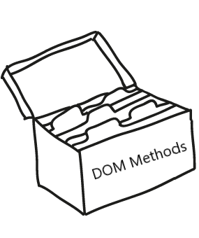
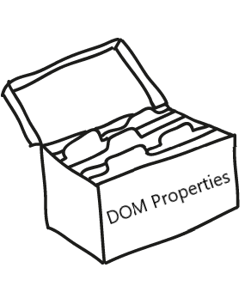
DOM Methods
DOM Methods - actions you can perform on HTML elements
DOM Properties - values of HTML elements that you can set or change

Slide 13

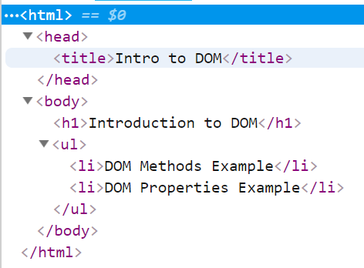


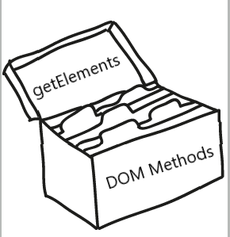
DOM Methods - Example
With HTML DOM methods we can get every element from the DOM we want

Slide 14
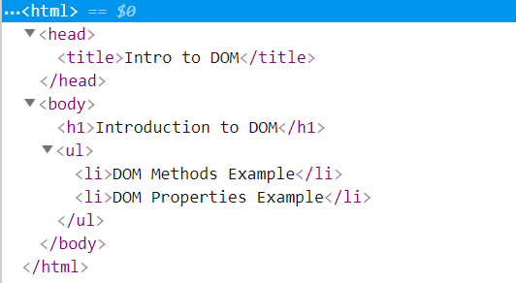
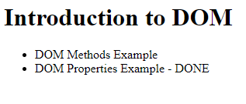
DOM Methods - Example (2)
HTML DOM properties allow us to change the value on every html element we want

Slide 15
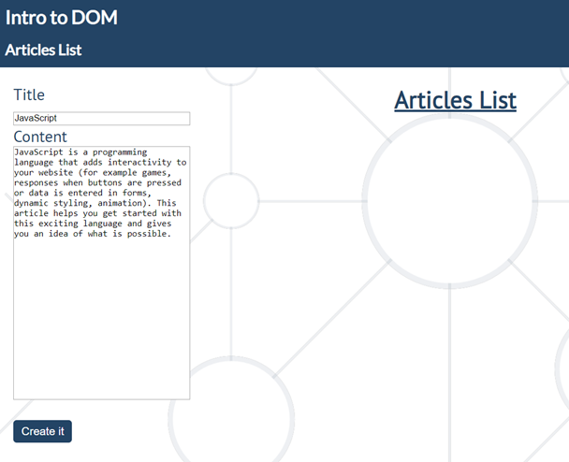
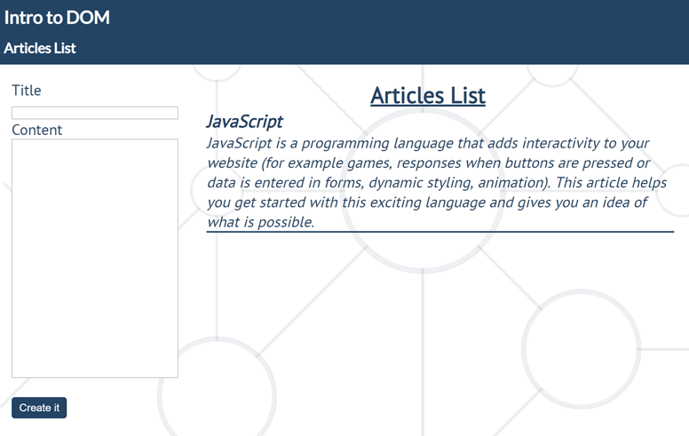
Problem: Articles List
Create articles and append them into the articles list

Slide 16
Solution: Articles List
function createArticle(){
let title = document.getElementById('createTitle').value
let text = document.getElementById('createContent').value
let articlesList = document.getElementById('articles')
if(title !== '' && text !== '') {
let article = document.createElement('article')
let h3 = document.createElement('h3')
h3.textContent = title
let p = document.createElement('p')
p.textContent = text
article.appendChild(h3)
article.appendChild(p)
articlesList.appendChild(article)
}
document.getElementById('createTitle').value = ""
document.getElementById('createContent').value = ""
}
Check your solution here: https://judge.softuni.bg/Contests/Practice/Index/1425#0

Slide 17

DOM Manipulations
Modify the DOM Tree

Slide 18
DOM Manipulations
There are a few ways to find a certain HTML element in the DOM:
by id - getElementById
by tag name - getElementsByTagName
by class name – getElementsByClassName
by css selector – querySelector(condition)

Slide 19

DOM Manipulations
The HTML DOM allows JavaScript to change the content of HTML elements.
innerHTML
Attribute
setAttribute
style.property

Slide 20

DOM Manipulations
We can create, append and remove HTML element dynamically.
removeChild
appendChild
replaceChild
write

Slide 21


Practice: Document Object Model
Live Exercises in Class (Lab)

Slide 22

DOM Events
Handling DOM Events

Slide 23
DOM Events
Events are actions or occurrences that happen in the system you are programming, which the system tells you about so you can respond to them in some way if desired
DOM Events are sent to notify code of interesting things that have taken place

Slide 24
DOM Events
Each event is represented by an object which is based on the Event interface, and may have additional custom fields and/or functions used to get additional information about what happened
Events can represent everything from basic user interactions to automated notifications of things happening in the rendering model

Slide 25
DOM Events
Mouse events
Touch events
DOM / UI events
click
mouseover mouseout mousedown
mouseup
touchstart
touchend
touchmove
touchcancel
load
unload
resize dragstart / drop
Keyboard events
Focus events
Form events
keydown
keypress
keyup
focus
blur
input change submit reset

Slide 26
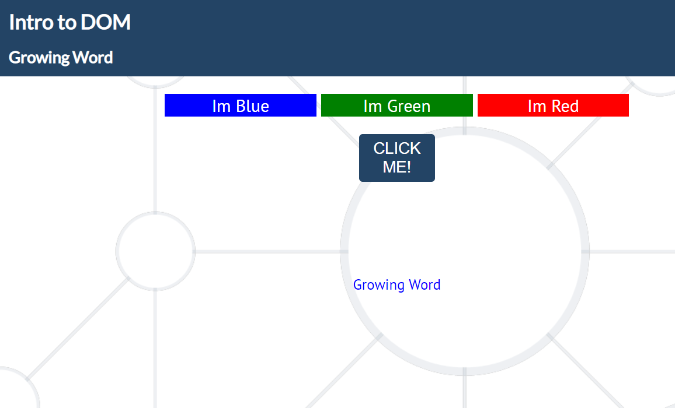
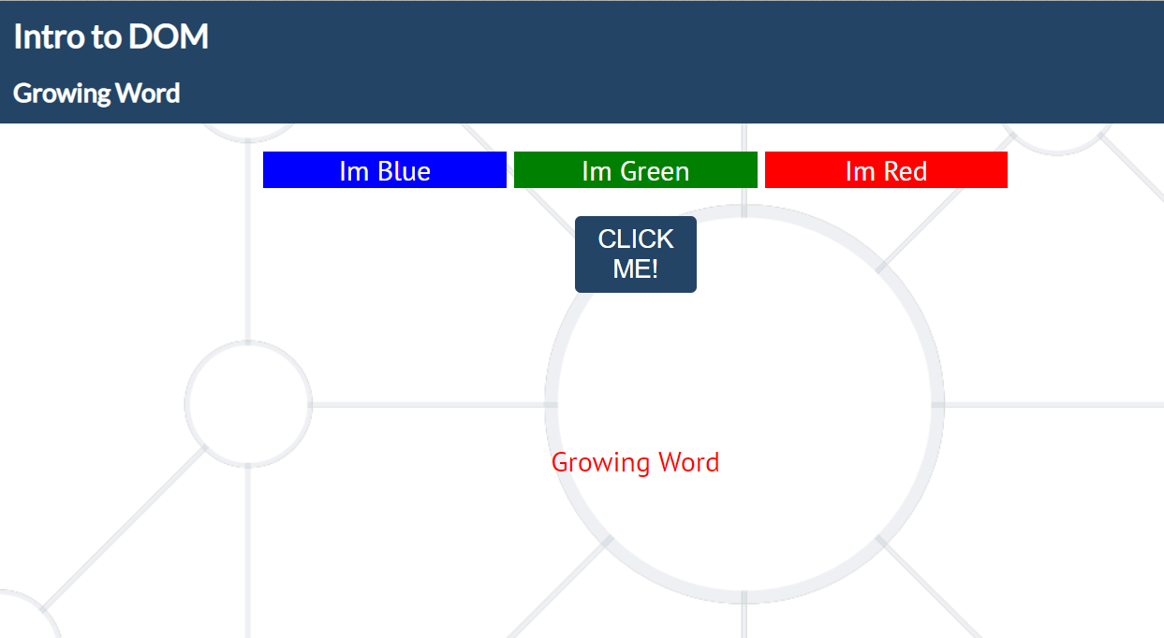
Problem: Growing Word
Change the size and the color of a paragraph on every click
Check your solution here: https://judge.softuni.bg/Contests/Practice/Index/1425#2

Slide 27
Solution: Growing Word
function solve(){
let clicks = 0;
document.querySelector('button').addEventListener('click',
() => {
let p = document.querySelector('#exercise p');
if(clicks % 3 === 0){
p.style.color = "blue";
} else if (clicks % 3 === 1){
p.style.color = "green";
} else if(clicks % 3 === 2){
p.style.color = "red";
}
clicks++;
p.style.fontSize = `${clicks * 2}px`; });
}
Check your solution here: https://judge.softuni.bg/Contests/Practice/Index/1425#2

Slide 28
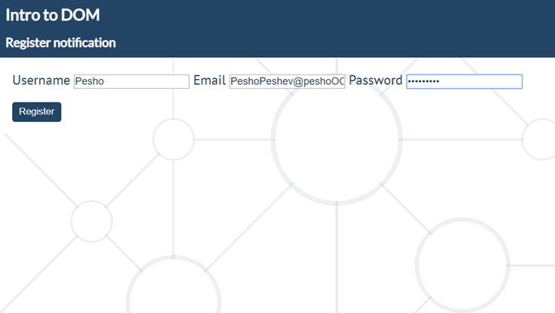
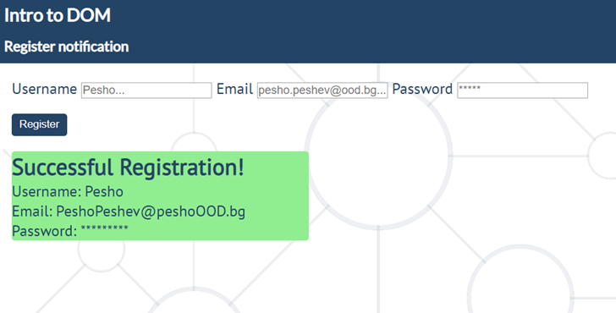
Problem: Register Notification
Create a JS functionality that shows notification after successful registration
Check your solution here: https://judge.softuni.bg/Contests/Practice/Index/1425#3

Slide 29
Practice: Document Object Model
Live Exercises in Class (Lab)

Slide 30

Summary
What is DOM?
Definition and DOM HTML
DOM Methods
Methods and Properties
DOM Manipulations
Find, Change, Add and Remove HTML elements
…
…
…

Slide 31
https://softuni.bg/courses/javascript-fundamentals

Slide 32












SoftUni Diamond Partners

Slide 33




SoftUni Organizational Partners

Slide 34




Trainings @ Software University (SoftUni)
Software University – High-Quality Education and Employment Opportunities
softuni.bg
Software University Foundation
http://softuni.foundation/
Software University @ Facebook
facebook.com/SoftwareUniversity
Software University Forums
forum.softuni.bg

Slide 35

License
This course (slides, examples, demos, videos, homework, etc.) is licensed under the "Creative Commons Attribution-NonCommercial-ShareAlike 4.0 International" license

